Slide 2
From the pen of author David Ebsworth…

Slide 3
Intrigue, mayhem and murder…

Slide 4
At the East India Company outpost in old Madras…

Slide 5
Through the Glorious Revolution of 1688…

Slide 6
To the reign of Queen Anne and the 1715 Jacobite Rebellion…

Slide 7
Catherine must survive it all!

Slide 8
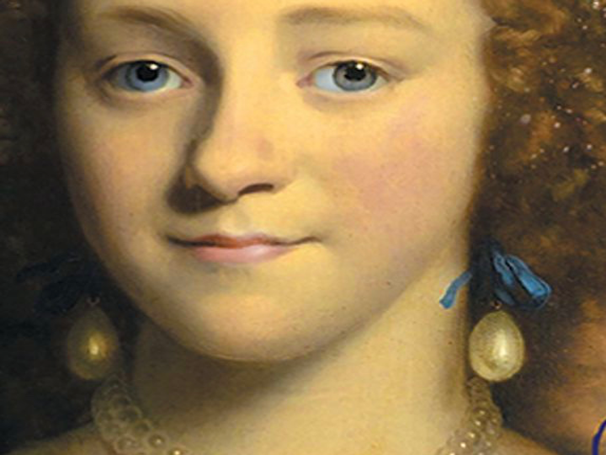

Slide 9
And though Elihu Yale may have bequeathed his name to one of the world’s finest universities…

Slide 10
To Catherine he left nothing but the slur of branding her a “wicked wife.”

Slide 11
Wicked? You’ll need to make up your own mind as you read…

Slide 13
Published by SilverWood Books
Cover designs by Cathy Helms at Avalon Graphics
Original cover version of The Parting Glass by Monika Evans
www.davidebsworth.com
davemccall@davidebsworth.org

